Slide 1









Table of
Contents
Predicting
Schizophrenia
Presented by:
Group 7B

Slide 2

















Table of
Contents

Slide 3
Overview
24M+ people affected globally (WHO)
Diagnosis often occurs late which can worsen outcomes
Problem Statement & Background
Early symptoms are vague causing difficult detection
Traditional methods lack predictive accuracy

Slide 4
Overview
24M+ people affected globally (WHO)
Diagnosis often occurs late which can worsen outcomes
Problem Statement & Background
Early symptoms are vague causing difficult detection
Traditional methods lack predictive accuracy
Notes:
Affects millions globally
Generic symptoms like depression and isolation
Can be attributed to other mental illnesses
Only after psychosis is it detected

Slide 5
Aim
Predict High Risk Individuals
Preprocess and Clean Dataset
Develop Dashboard
Interpret Results
Analyze Key Risk Factors
Build & Evaluate Models

Slide 6
Aim
Predict High Risk Individuals
Preprocess and Clean Dataset
Develop Dashboard
Interpret Results
Analyze Key Risk Factors
Build & Evaluate Models

Slide 7
Lit.
Review
Major & Important Takeaways from the Literature Review
Schizophrenia is underdiagnosed; early intervention is critical (Lewis & Lieberman, 2000).
Machine learning has been successfully applied for psychiatric diagnosis (Vellido et al., 2019; Orrù et al., 2020).
The CRISP-DM methodology provides a best-practice framework for data mining in healthcare (Shearer, 2000; Chapman et al., 2000).

Slide 8
Lit.
Review
Major & Important Takeaways from the Literature Review
Schizophrenia is underdiagnosed; early intervention is critical (Lewis & Lieberman, 2000).
Machine learning has been successfully applied for psychiatric diagnosis (Vellido et al., 2019; Orrù et al., 2020).
The CRISP-DM methodology provides a best-practice framework for data mining in healthcare (Shearer, 2000; Chapman et al., 2000).
Notes:
- Our work builds upon a robust body of literature.
Prior studies have demonstrated that early detection remains a challenge, while machine learning offers promising solutions.
Notably, research by Vellido et al. and Orrù et al. has validated the use of predictive models in psychiatric contexts.
Additionally, using frameworks like CRISP-DM—outlined by Shearer and Chapman—ensured our methodology was systematic and ethically rigorous.

Slide 9
Lit.
Review
Major & Important Takeaways from the Literature Review
Interpretability in models (e.g., logistic regression) is crucial to align with clinical practice (Sharma et al., 2021; Shafiei, 2021).
Why Logistic Regression?
Even in large datasets, complex models like SVMs and XGBoost showed no major advantage over logistic regression (AUC ≈ 0.70) (Bracher-Smith et al., 2022).
You can see clearly how each factor (like age or family history) changes the risk. (Shafiei et al., 2021).
Simple, Transparent, and
Clinically Trustworthy
Numbers and yes/no info are perfect for logistic regression.
Fair Performance
Fits Our Data
In a remission prediction study, logistic regression performed well on real clinical data and was externally validated in Canada, showing practical reliability
(Shafiei et al., 2021).
Our team can use logistic regression without needing deep learning skills, GPUs, or high memory, unlike models like CNN-LSTM (Sadeghi et al., no date).
Logistic regression avoids overfitting with regularization, unlike complex models like DNNs that need massive data to prevent it.
Validated in Real-World Settings
Fits Our Skills & Resources
Less Risk of Problems
Like Overfitting
Notes:
Importantly, we prioritized interpretability so that clinicians can trust and understand how the model predicted.”

Slide 10
Lit.
Review
Why Logistic Regression?
Even in large datasets, complex models like SVMs and XGBoost showed no major advantage over logistic regression (AUC ≈ 0.70) (Bracher-Smith et al., 2022).
You can see clearly how each factor (like age or family history) changes the risk. (Shafiei et al., 2021).
Simple, Transparent, and
Clinically Trustworthy
Numbers and yes/no info are perfect for logistic regression.
Fair Performance
Fits Our Data
In a remission prediction study, logistic regression performed well on real clinical data and was externally validated in Canada, showing practical reliability
(Shafiei et al., 2021).
Our team can use logistic regression without needing deep learning skills, GPUs, or high memory, unlike models like CNN-LSTM (Sadeghi et al., no date).
Logistic regression avoids overfitting with regularization, unlike complex models like DNNs that need massive data to prevent it.
Validated in Real-World Settings
Fits Our Skills & Resources
Less Risk of Problems
Like Overfitting
Notes:
Importantly, we prioritized interpretability so that clinicians can trust and understand how the model predicted.”

Slide 11
Lit.
Review
Why Logistic Regression?
Even in large datasets, complex models like SVMs and XGBoost showed no major advantage over logistic regression (AUC ≈ 0.70) (Bracher-Smith et al., 2022).
You can see clearly how each factor (like age or family history) changes the risk. (Shafiei et al., 2021).
Simple, Transparent, and
Clinically Trustworthy
Numbers and yes/no info are perfect for logistic regression.
Fair Performance
Fits Our Data
In a remission prediction study, logistic regression performed well on real clinical data and was externally validated in Canada, showing practical reliability
(Shafiei et al., 2021).
Our team can use logistic regression without needing deep learning skills, GPUs, or high memory, unlike models like CNN-LSTM (Sadeghi et al., no date).
Logistic regression avoids overfitting with regularization, unlike complex models like DNNs that need massive data to prevent it.
Validated in Real-World Settings
Fits Our Skills & Resources
Less Risk of Problems
Like Overfitting
Notes:
Even in large datasets, complex models showed no major advantage over logistic regression (AUC ≈ 0.70)
The paper published by Shafiei conducted a remission prediction study
Log Reg performed well on real clinical data and was externally validated in Canada
Gave us confidence that this was a good model for our project
Our team can doesn’t need to possess more advanced skills and equipment to build more advanced models
It avoids overfitting (memorizing the data too much)

Slide 12
Methodology

Slide 13
Methodology
CRISP-DM Framework
1
2
3
Business Understanding
Data
Understanding
Data
Preparation
Notes:
Business Understanding: “We started by clearly defining our goal—to develop an interpretable machine learning model that predicts schizophrenia risk and supports early intervention.
Data Understanding: “We examined our Kaggle dataset of 10,000 anonymized patient records, identifying key features like age, gender, family history, and medication adherence. This deep dive into the data’s characteristics allowed us to pinpoint potential challenges, such as class imbalances and missing values
Data Preparation: “In this step, we cleaned and transformed the raw data by handling missing values, translating text, and applying one-hot encoding to categorical variables. Ensured our dataset was ready to derive accurate interpretations.

Slide 14
Methodology
CRISP-DM Framework
4
5
6
Modelling
Evaluation
Deployment
Notes:
Evaluation: “Our model was rigorously tested using five-fold cross-validation and evaluated on several metrics (accuracy, precision, recall, AUC) to ensure performance consistency.
Deployment: This is when our model is deployed to be used by clinicians in real-world settings

Slide 15
Results
Key EDA Findings
Diagnosis
Distribution
Living
Area
Gender
28.87% diagnosed vs. 71.13% non-diagnosed (class imbalance)
Slightly higher risk in males
Minor urban bias in diagnosis

Slide 16
Results
Key EDA Findings
Diagnosis
Distribution
Living
Area
Gender
Slightly higher risk in males
28.87% diagnosed vs. 71.13% non-diagnosed (class imbalance)
Minor urban bias in diagnosis

Slide 17
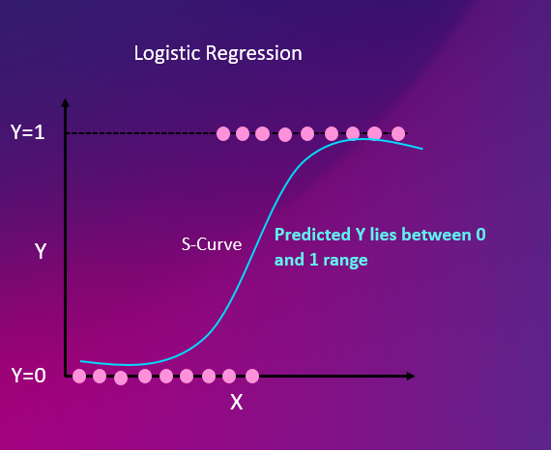
Results
Key EDA Findings
Family
History
Medication
Adherence
Significant risk factor (54.7% diagnosed among those with a family history)
Lower adherence correlates with higher suicide attempts and positive symptom severity
Logistic
Regression
This is the graph of a sigmoid function which ensures the outputted values are always between 0 and 1.

Slide 18



Results
Logistic
Regression
This is the graph of a sigmoid function which ensures the outputted values are always between 0 and 1.
Building the Model
Challenge
Improvements
Final Product

Slide 19
Results
Building the Model
Challenge
Improvements
Final Product
Notes:
Initially, our model yielded unrealistically perfect scores due to data leakage—a byproduct of treating categorical data as numerical.
To resolve this, we applied one-hot encoding and carefully separated numerical from categorical inputs.
This adjustment led us to a final logistic regression model built with the Keras Functional API, which not only performed robustly but was also transparent and interpretable for clinical use.”

Slide 20
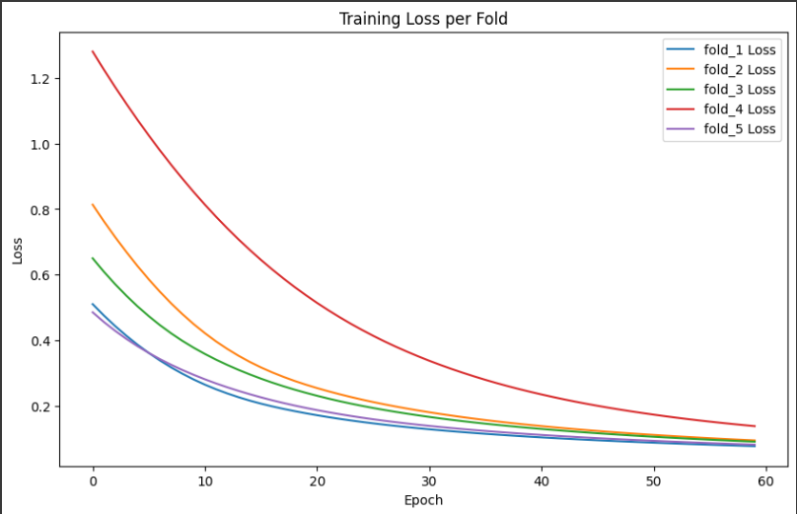
Results
Building the Model
Five-Fold Cross Validation
Accuracy
Precision & Recall
AUC
~ 98.34%
~ 0.9992
~ 95% ; ~ 98.44%
Test Set Evaluation
Accuracy
Precision & Recall
AUC
~ 98.7%
~ 0.99978
~ 96.3% ; ~ 99.31%
Notes:
Our training loss curves show a steady decline with smooth convergence, confirming stable model training without overfitting.

Slide 21
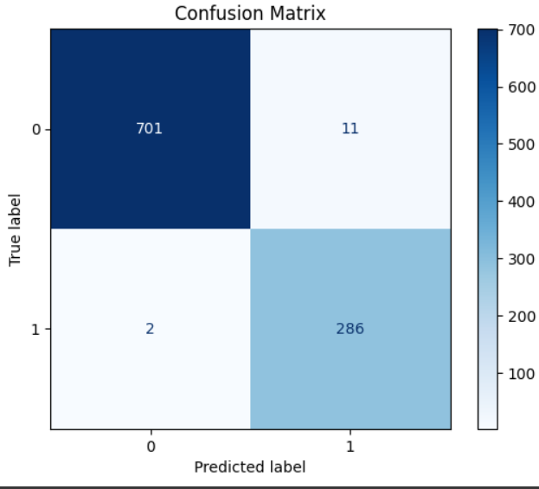
Results
Five-Fold Cross Validation
Accuracy
Precision & Recall
AUC
~ 98.34%
~ 0.9992
~ 95% ; ~ 98.44%
Test Set Evaluation
Accuracy
Precision & Recall
AUC
~ 98.7%
~ 0.99978
~ 96.3% ; ~ 99.31%

Slide 22
Results
Notes:
We have also built a dashboard which displays key indicators

Slide 23
Discussions

Slide 24
Discussions

Slide 25
Discussions
Demonstrates how rigorous preprocessing elevates simple models to high accuracy.
Our model’s performance is consistent with prior work (e.g., Mørch et al., 2018; Orrù et al., 2020)
Implications: Supports integration of data-driven tools in clinical practice with interpretable outputs.
Limitations Noted: dataset homogeneity and lack of external validation.
Notes:
Our findings are in line with the literature. Studies by Mørch and Orrù have shown that machine learning can significantly improve early diagnostic accuracy.
Our work underscores the idea that even simple yet well-tuned models like logistic regression—when processed and evaluated rigorously—can deliver excellent performance.
However, we must acknowledge limitations such as our dataset’s lack of demographic diversity and the need for external validation to fully generalize our results.

Slide 26
Recommendations
Recommendations:
Integrate interpretable models into clinical workflows.
Encourage collaborative data sharing for more diverse datasets.
Future Work:
Perform external validations across different cohorts.
Explore advanced or ensemble models while maintaining interpretability.
Incorporate Explainable AI (XAI) methods for deeper insight.

Slide 27
Recommendations
Recommendations:
Integrate interpretable models into clinical workflows.
Encourage collaborative data sharing for more diverse datasets.
Future Work:
Perform external validations across different cohorts.
Explore advanced or ensemble models while maintaining interpretability.
Incorporate Explainable AI (XAI) methods for deeper insight.
Limitations:
Dataset homogeneity
Overfitting risk due to controlled data environments
Notes:
Based on our study, we recommend that clinitions consider adopting interpretable predictive models for early schizophrenia detection and sharing data to cover demographics.
A future direction is to enhance our work by validating on more diverse datasets and exploring more complex models and
Incorporating Explainable AI techniques to further improve clinicians’ trust and understanding of model decisions.”

Slide 28
Recommendations
Limitations:
Dataset homogeneity
Overfitting risk due to controlled data environments

Slide 29

References
Sadeghi, D. et al. (no date) “Automatic Diagnosis of Schizophrenia in EEG Signals Using CNN-LSTM Models Afshin Shoeibi.”
Shafiei, A. (2021) “Prediction modelling using logistic regression and constrained confidence partitioning: remission in real-world samples of patients living with schizophrenia,” *Journal of Psychiatric Research* [Preprint].
Bracher-Smith, M. et al. (2022) “Machine learning for prediction of schizophrenia using genetic and demographic factors in the UK biobank,” *Schizophrenia research*, 246, pp. 156–164. Available at: https://doi.org/10.1016/j.schres.2022.06.006.
Vellido, A., Martín-Guerrero, J. D., & Lisboa, P. J. (2019). Making machine learning models interpretable for clinical psychiatry. Computer Methods and Programs in Biomedicine, 180, 105020. https://doi.org/10.1016/j.cmpb.2019.105020
Sharma, P., Chaudhary, H., & Bansal, D. (2021). Predictive modeling in schizophrenia using linear regression: Toward interpretable clinical tools. Journal of Psychiatric Research, 139, 269–278. https://doi.org/10.1016/j.jpsychires.2021.05.036

Slide 30
References
Sadeghi, D. et al. (no date) “Automatic Diagnosis of Schizophrenia in EEG Signals Using CNN-LSTM Models Afshin Shoeibi.”
Shafiei, A. (2021) “Prediction modelling using logistic regression and constrained confidence partitioning: remission in real-world samples of patients living with schizophrenia,” *Journal of Psychiatric Research* [Preprint].
Bracher-Smith, M. et al. (2022) “Machine learning for prediction of schizophrenia using genetic and demographic factors in the UK biobank,” *Schizophrenia research*, 246, pp. 156–164. Available at: https://doi.org/10.1016/j.schres.2022.06.006.
Vellido, A., Martín-Guerrero, J. D., & Lisboa, P. J. (2019). Making machine learning models interpretable for clinical psychiatry. Computer Methods and Programs in Biomedicine, 180, 105020. https://doi.org/10.1016/j.cmpb.2019.105020
Sharma, P., Chaudhary, H., & Bansal, D. (2021). Predictive modeling in schizophrenia using linear regression: Toward interpretable clinical tools. Journal of Psychiatric Research, 139, 269–278. https://doi.org/10.1016/j.jpsychires.2021.05.036

Slide 31
References
Orrù, G., et al. (2020). Machine learning in psychiatry: A systematic review. Neuroscience & Biobehavioral Reviews, 36(1), 58–70.
Lewis, D.A. and Lieberman, J.A. (2000) Review Catching Up on Schizophrenia: Natural History and Neurobiology diac malformations, and a distinctive facial appearance), which carries a substantially increased risk of schizo-phrenia, although the incidence of bipolar disorder in, Neuron.
Shearer, C. (2000). The CRISP-DM model: The new blueprint for data mining. Journal of Data Warehousing, 5(4), 13–22.
Chapman, P., Clinton, J., Kerber, R., Khabaza, T., Reinartz, T., Shearer, C. and Wirth, R. (2000) CRISP-DM 1.0: Step-by-step data mining guide. Available at: https://mineracaodedados.files.wordpress.com/2012/12/crisp-dm-1-0.pdf

Slide 32

Conclusion
Successfully developed an interpretable logistic regression model for early schizophrenia detection.
Early intervention can significantly improve patient outcomes.

Slide 33
Conclusion
Successfully developed an interpretable logistic regression model for early schizophrenia detection.
Early intervention can significantly improve patient outcomes.
Notes:
In conclusion, our project has demonstrated that an interpretable machine learning model—built using robust preprocessing and the CRISP-DM framework—can effectively predict early schizophrenia risk.
The outstanding performance metrics serve as evidence for the same.
This encourages its potential use in clinical settings, where early intervention is crucial to patient outcomes.

